Slide 1
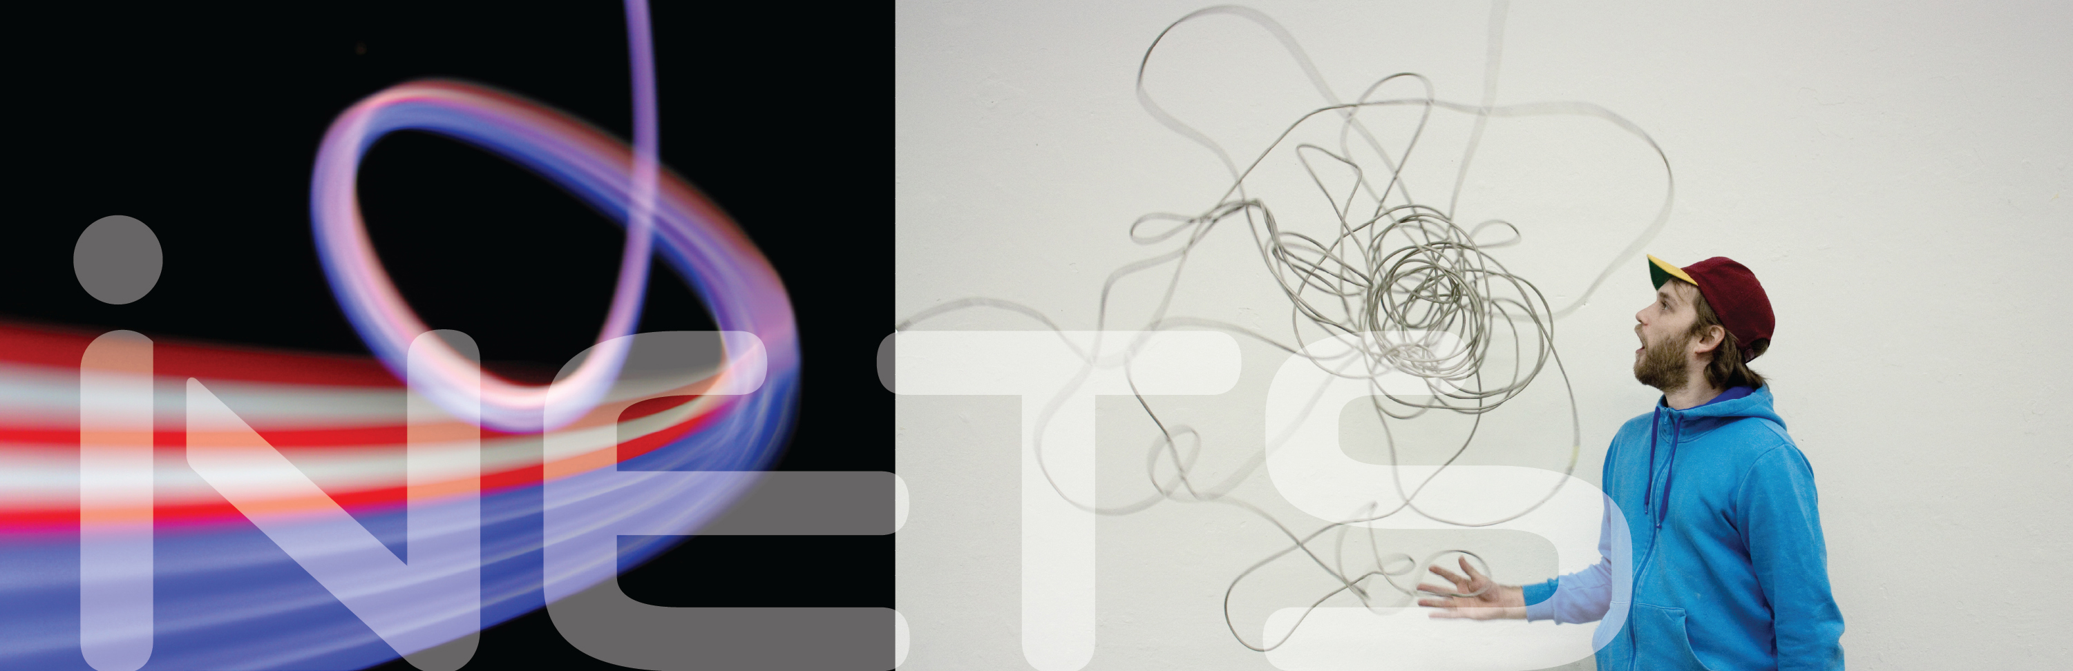
Comparison of Machine Learning Techniques Mobile Phone Motion & Usage Classification Alexander Gladis
Notes:
M

Slide 2
Recap: Sensors on Android Phones
Notes:
A

Slide 3
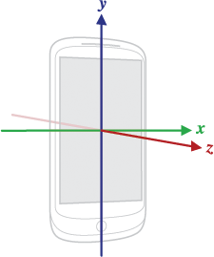
Motion-related sensors supported by Android SDK
Raw hardware sensor data
Accelerometer (Linear Acceleration + Gravity)
Gyroscope (Angular Velocity)
Magnetometer (Geomagnetic Field)
Virtual software sensors (preprocessed sensor data)
Rotation Vector Sensor (A/G/M)
Game Rotation Vector Sensor (A/G)
Maximum sampling frequency:
No requirements by the Android standard!
On most phones: 150-200Hz
To make sure that we support almost all phones: max. 100Hz
Notes:
M

Slide 4
Other interesting sensors
Ambient light level sensor
Proximity (relative to device screen) sensor
Present on almost all (modern) devices
Possibly helpful to determine if phone is in pocket or held up to the user’s ear
This cannot always be certainly determined based only on phone position/orientation
Notes:
M

Slide 5
Machine Learning Techniques
(based on feature extraction)
Notes:
A

Slide 6
Almost exclusively used in recent studies
Studies mostly focus on classification of user motion
Approaches and results easily transferable to phone motion
State-of-the-Art Techniques
Bayesian Networks
Support Vector Machines (SVM)
K-Nearest-Neighbor (KNN)
Random Forest
Logistic Regression
…
Most of my work will be the development of a “good” set of extracted features (feature engineering)
Time domain: Means, StdDevs, Zeros, RMS, Quantiles, …
Frequency domain: FFT coefficients, spectral energy, …
Notes:
M

Slide 7
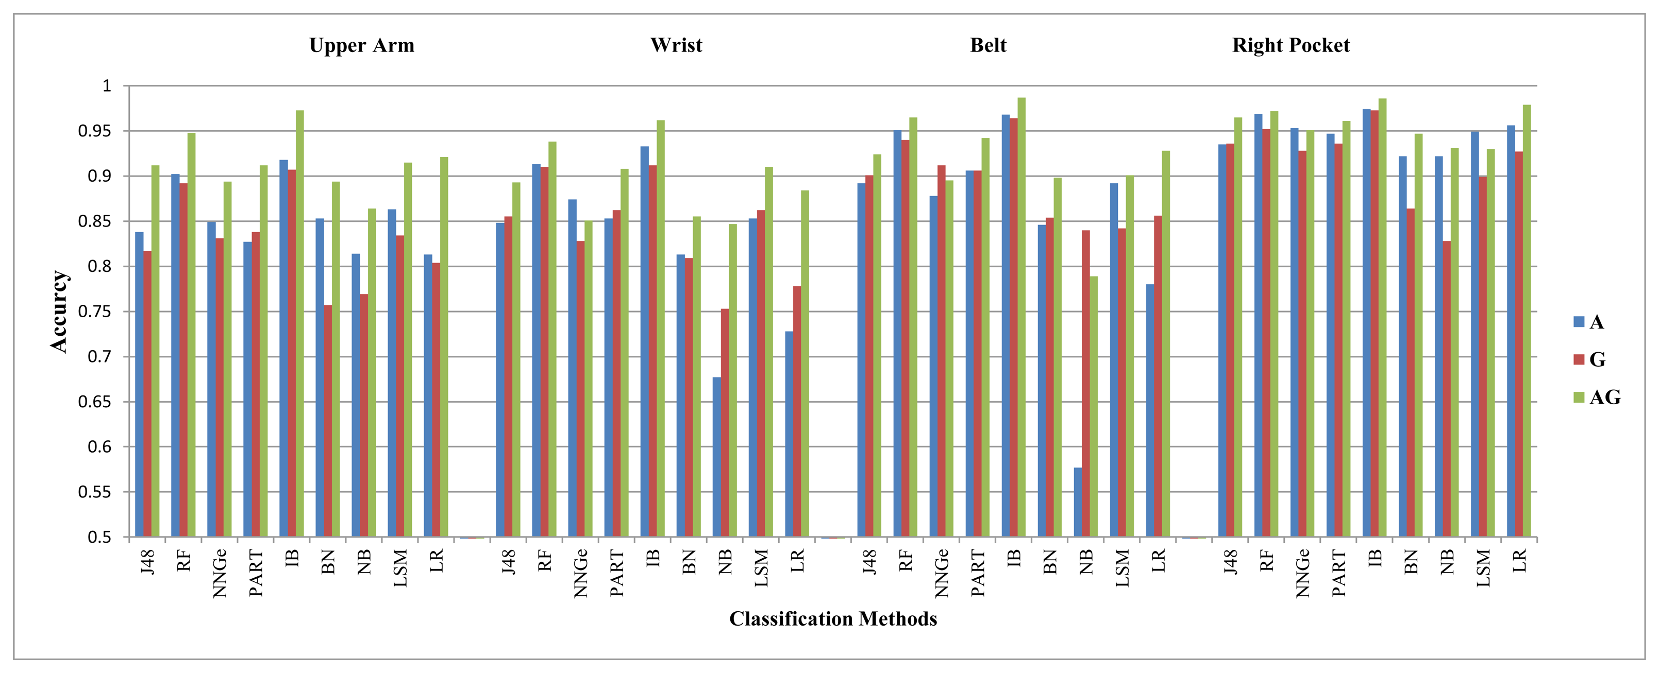
Thorough comparison for user motion classification available
Example: Classification of the user motion “walking”
http://www.mdpi.com/1424-8220/14/6/10146/htm
Notes:
M

Slide 8
Best suited for user motion classification:
Random Forest
K-Nearest-Neighbor (in the study: K = 1)
Similar results from other studies
We should also perform such a comparison
to confirm the results
to make sure they also apply to phone motion classification
starting with RF and KNN
Advantage: Very similar input data for those techniques
Notes:
M

Slide 9
Machine Learning Techniques
(that do not require feature extraction)
Notes:
A

Slide 10
Not (or at least very rarely) used in recent studies
Artificial Neural Networks (ANN)
Variants that could suit our needs:
Recurrent Neural Networks (RNN)
Unit Connections = Directed Cycle
Allows for dynamic temporal behavior
Suited for temporally connected input sequences
Consecutive sensor data from accelerometer / gyroscope
Only input data from the past available from the current state
For example Long Short-Term Memory (LSTM) RNNs
Bidirectional Neural Networks (BRNN)
Can be seen as an extension of RNNs
Input data from both, past and future, reachable from the current state
Able to interpret input data embedded into its context
Notes:
M

Slide 11
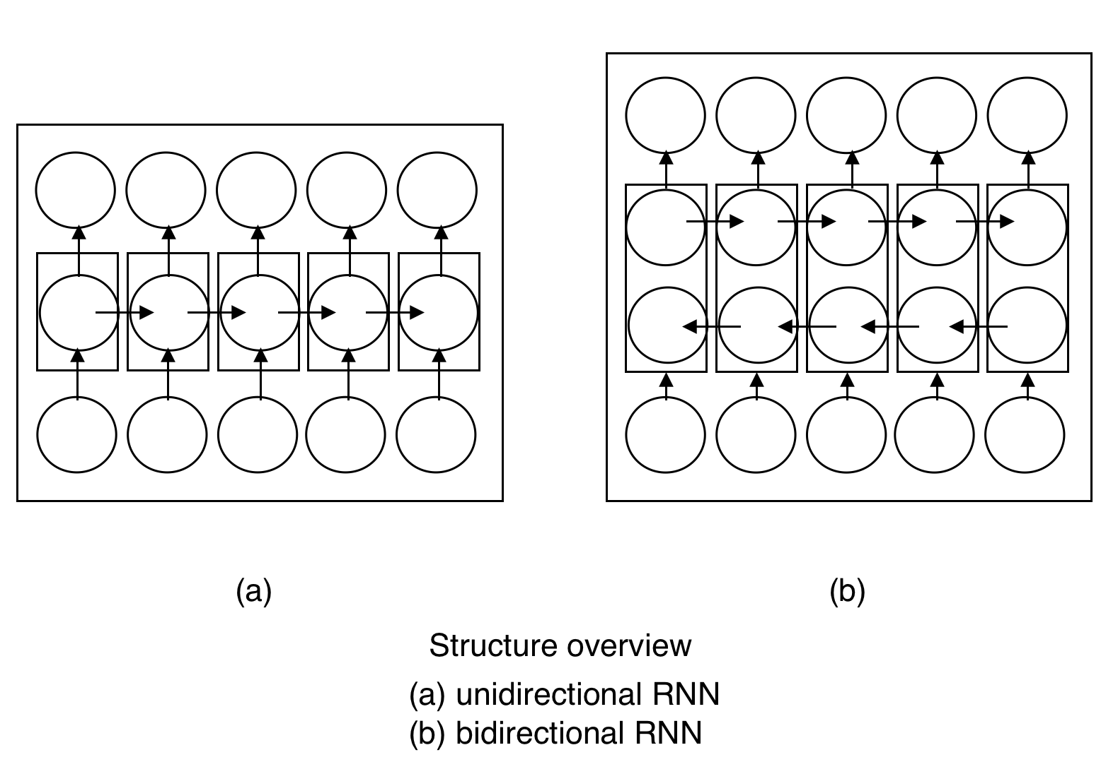
https://en.wikipedia.org/wiki/Bidirectional_recurrent_neural_networks
Notes:
M

Slide 12
What training data do we need?
Notes:
A

Slide 13
Simply collect as much sensor data as possible
Accelerometer
Gyroscope
Magnetometer?
Rotation Vector?
We can also compute this from A/G(/M) if needed…
Ambient Brightness/Proximity?
Use high sampling frequency (150Hz?)
We can discard/interpolate to lower sampling frequencies
We do not care about battery life or disk space here!
Labeled blocks (probably a few minutes) of continuous data for each activity/motion we want to classify
Cover different variants of activity
For example distinct ways of holding phone to ear
Notes:
M

Slide 14
In general:
The larger the training dataset, the better
Make sure we can reuse the training dataset for all classification techniques (a bit of preprocessing is OK!)
For feature-based classification:
A few (10-50) measurements should suffice for an acceptable accuracy
Each measurement should take a few (3-5) minutes
One set of measurements for each motion to be classified
For classification using raw data and neural networks:
Classification task becomes much more complex
Neural network needs to perform the “intelligent thinking” of feature engineering
A lot more (estimate: more than 500-1000) measurements required!
Notes:
M

Slide 15
Gathering the training dataset will require many resources
At least a month of time, probably more
Ideally we have multiple persons performing the same activity
Right-handed and left-handed people
Different habits (i.e. phone on left or right ear during a call)
Different phones are not necessarily required
Sensor data should be similar in terms of accuracy
We can start with a relatively small dataset
Set up the machine learning environment
Implement the algorithms and perform some first experiments
In parallel: Collect more training data
Once everything is implemented, we simply need to run the training again on a larger dataset
Notes:
M

Slide 16
Thank you for your attention!
Alexander Gladis, B.Sc. RWTH
alexander.gladis@rwth-aachen.de

